Slide 1



CRESCENT
Cherish the Joy of Giving!

Slide 2
Key Features offered by Crescent’s – GiveAwayApp
Users Engagement
This application is targeted to increase the reach of Outreach. It brings people from all over India, even outside from our organization, to come forward and contribute in the extraordinary program for noble cause called ‘Outreach’ by Cognizant.
A user can login only when they have registered on this application. While registering, if the user has selected the type of user as Volunteering user, then the account is activated instantly and post registration user gets the confirmation modal to continue with the application through logging in.
Efficient role Management for different User Role’s in the application
Dedicated Mailing System for providing real time update to users for every change in inventory-warehouse cycle
Give Away belonging, and spread smiles – ‘GiveAwayRequest Management’
Registered users, despite of any role, they can raise a request to give away something for a better cause. For each request of giveaway, user gets a unique user request token which is unique for that request. Once approved by administrator, user can submit their items to the warehouse they had selected while raising the request.

Slide 3
Key Features offered by Crescent’s – GiveAwayApp
Collecting items and Disbursing smiles – ‘Inventory Management’
Volunteer Users and Application administrator can see in their dashboard the list of available items in the inventory.
For any available item in the inventory, volunteer/administrator can request to acquire that item by just few clicks.
Application administrator is able to see all the raised requests and can approve/reject them. If approved, item count for the requested type gets decreased.
If the item count requested is equal to the total item count for that category, upon approval of that request inventory count for that category becomes zero. Inventory count is maintained at every instance of request->approve/reject cycle.
Item approved accounts for Outreach volunteer to acquire them and utilize for the need they have analyzed. Once they deliver the items, they update in their dashboard where the item was delivered and is being used.
Real time and visually attractive status projection in Dashboard Screen
At every moment of register->request->approve/reject cycle for items, inventory dashboard is updated instantly providing real time data to admins.

Slide 4
Key Features offered by Crescent’s – GiveAwayApp
Comprehensive Reporting System with Graphical representation and downloadable format option
GiveAway application provides a comprehensive reporting system which allows admin to get to know the status of inventory at any time. The Reports can be generated by Admin users only.
The reporting system has been designed in such a way that it provides report on inventory data based on certain facts such as Item Category, Item Status and Application Users.
The report is calculated over the dimension of time, with input parameter such as year, respective quarter and respective month.
According to the fact and dimension selection, our reporting system generates a bar graph in the application UI and also generates a detailed excel file with information which helps in projecting the real time data in an immersive way together.
Technologically upgraded, and brilliantly architected with the best design patterns and Cache Implementation to make hit on the performance as minimal as possible.

Slide 5
















Technology Stack

Slide 6
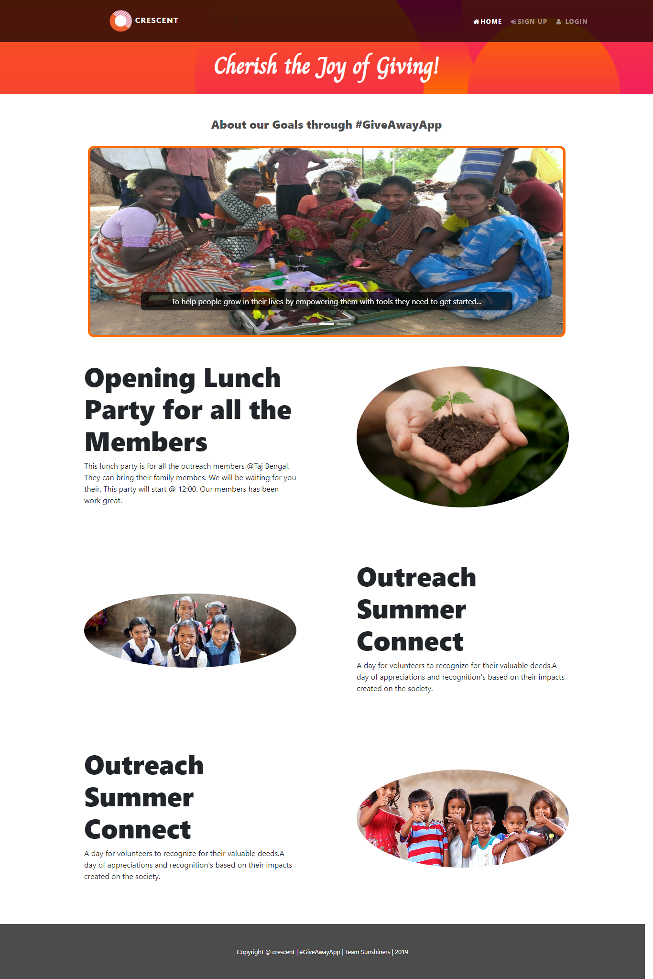
Home Home page will show Events created in chronological order.

Slide 7
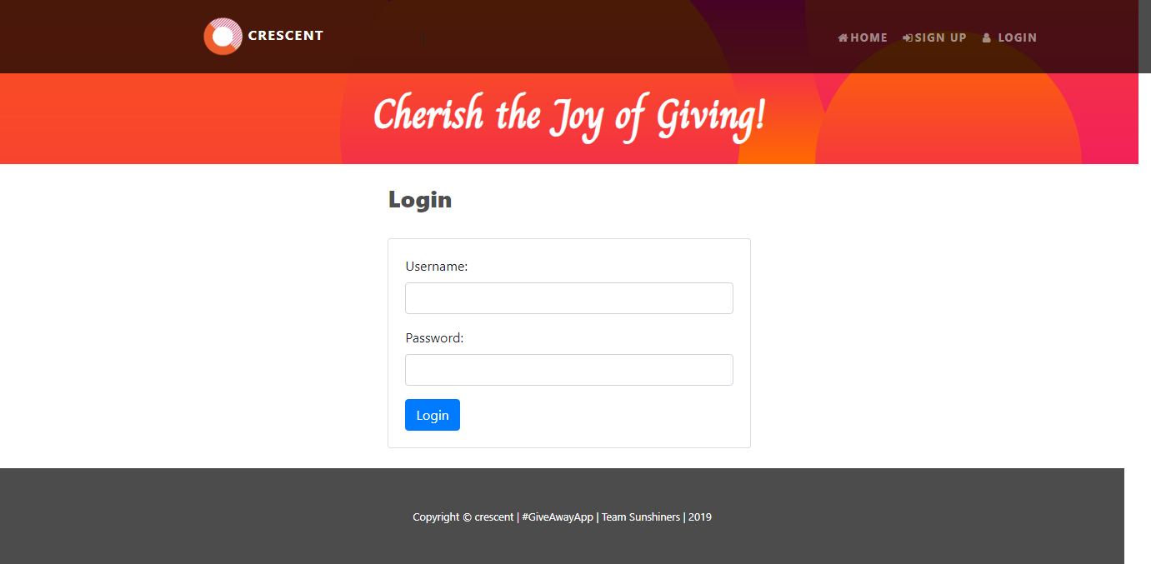
Login Users login to the application using their credentials. If credentials provided are valid, then they are logged into the application and the home page equips its self with bunch of options that are only available if a user has logged in.

Slide 8
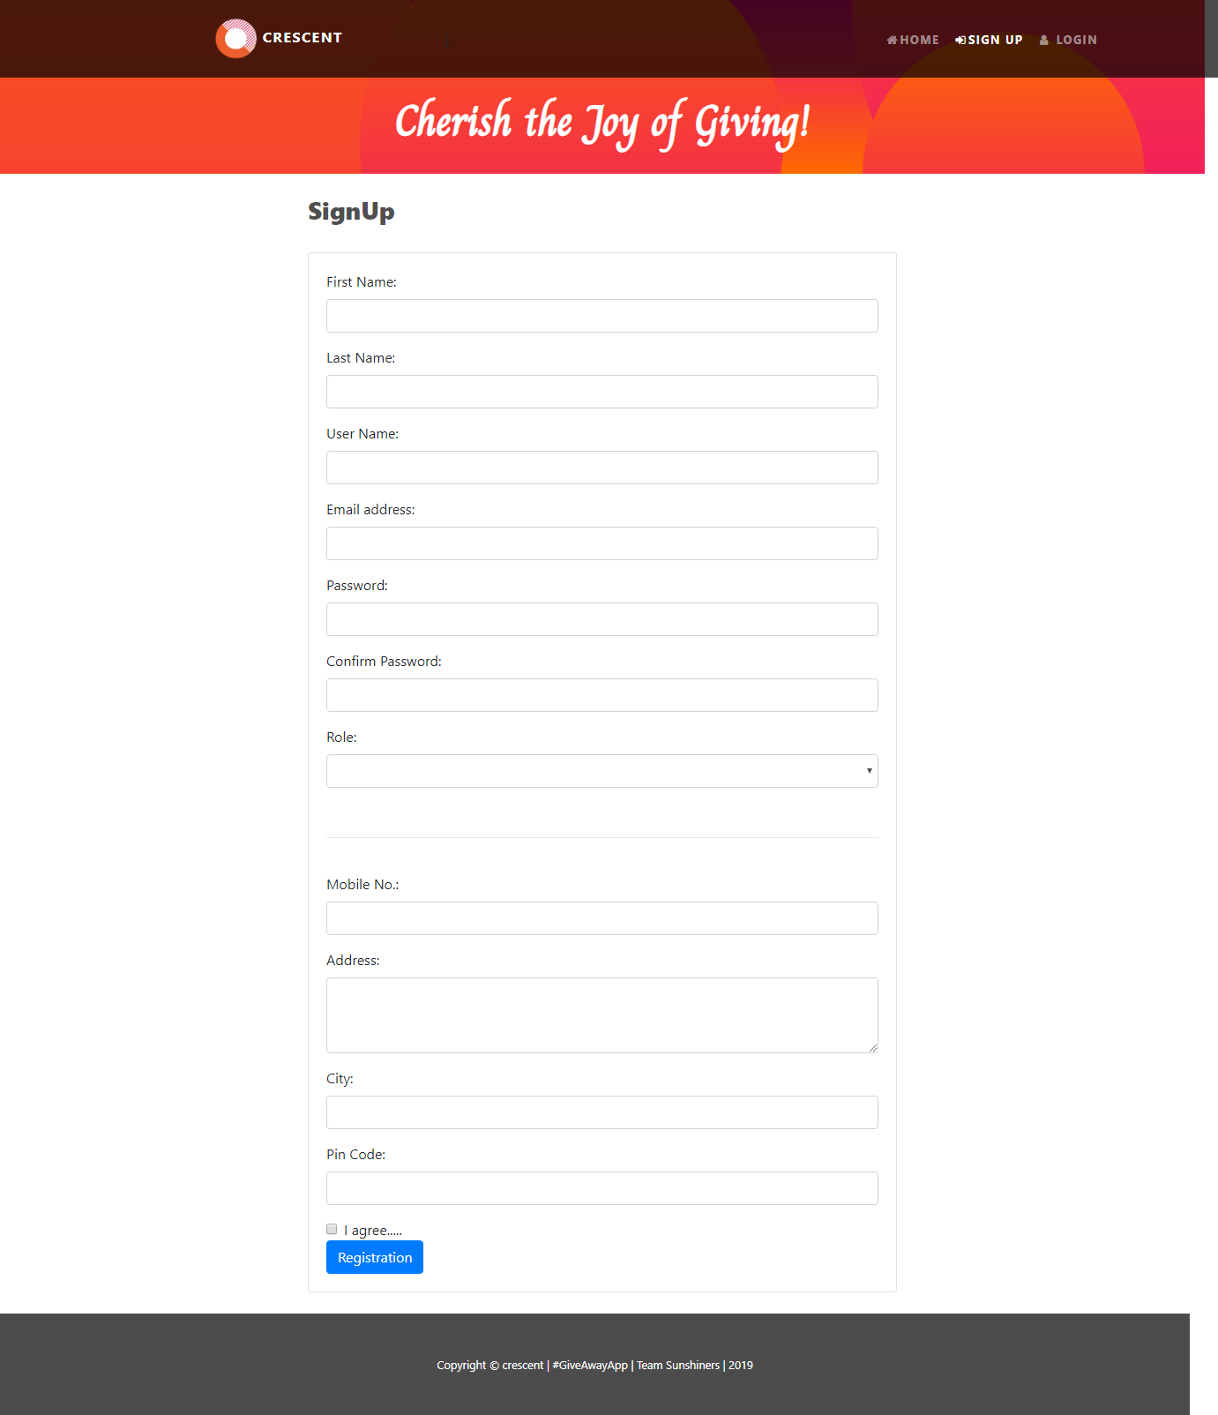
SignUp A User has to register him/ her for any transaction in application. While registering, if the user has selected the type of user as Volunteering user, then the account is activated instantly and post registration user gets the confirmation modal to continue with the application through logging in. For rest of the users, account doesn’t get approved instantly. The application administrator has to approve user registration request for Outreach Volunteer users and Application Administrators.

Slide 9
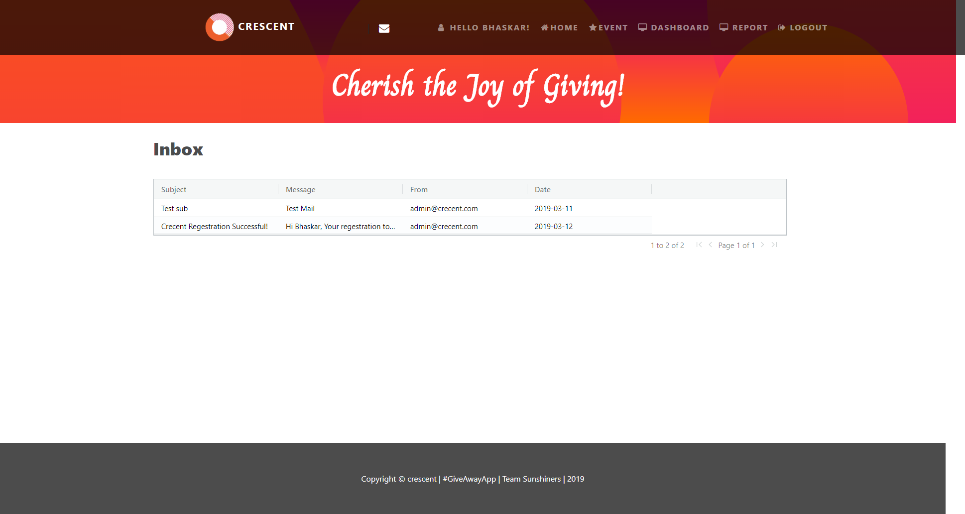
Inbox This screen is for showing the mail sent to the User for any type of communication done at different level of transactions . For example: Registration.

Slide 10
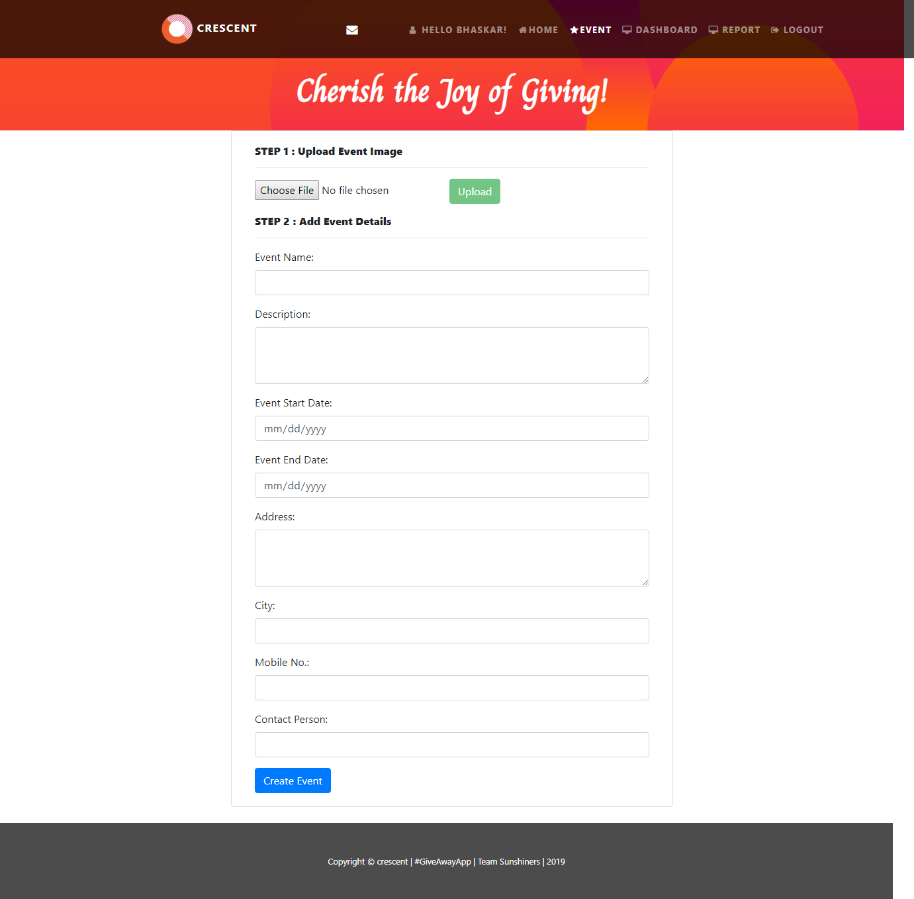
Event Submission From this screen Application administrator can create events with image on GiveAway app, which will/may be organized by Outreach people. This will help in increasing users engagement.

Slide 11
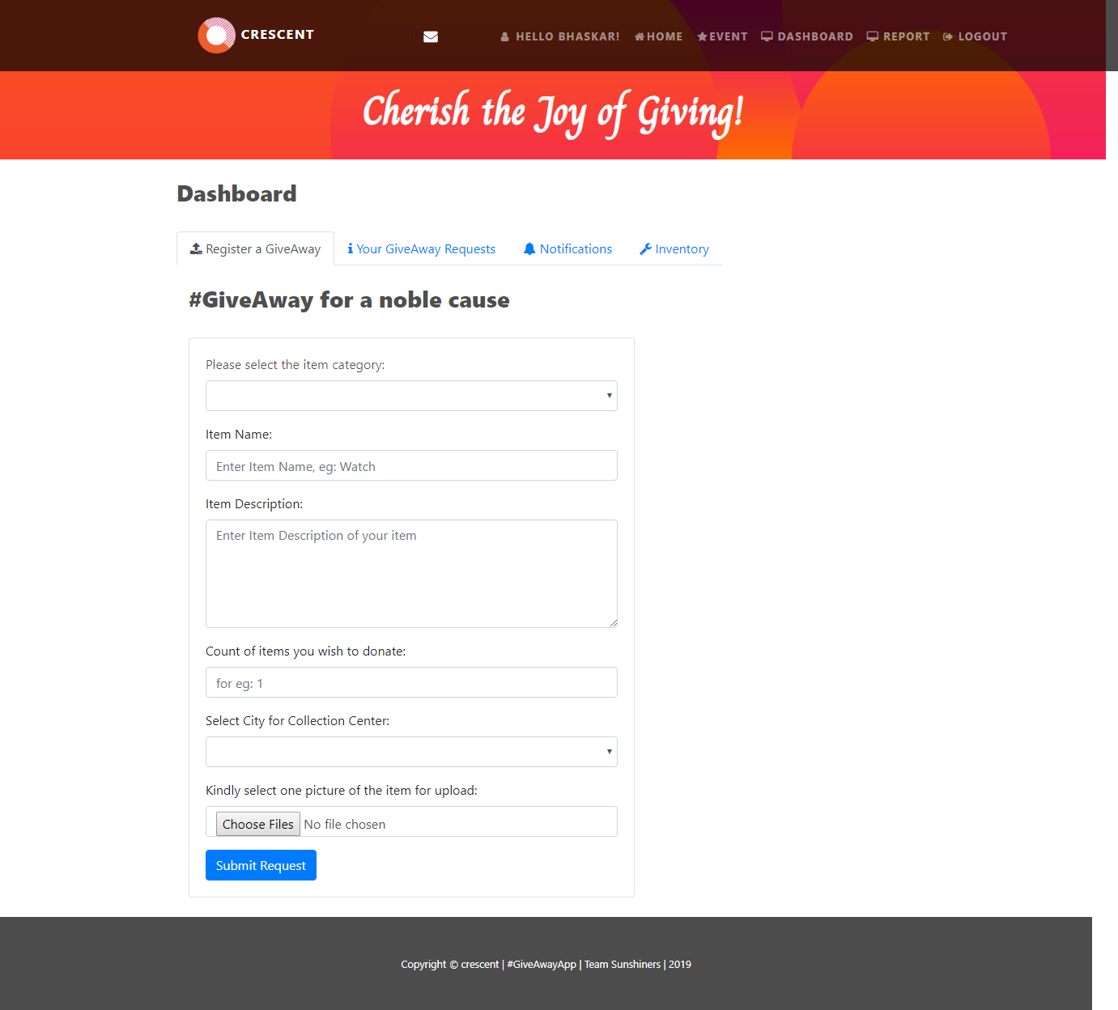
Dashboard 1. Register a GiveAway : This tab is use to submit the request for Giveaway item donation

Slide 12
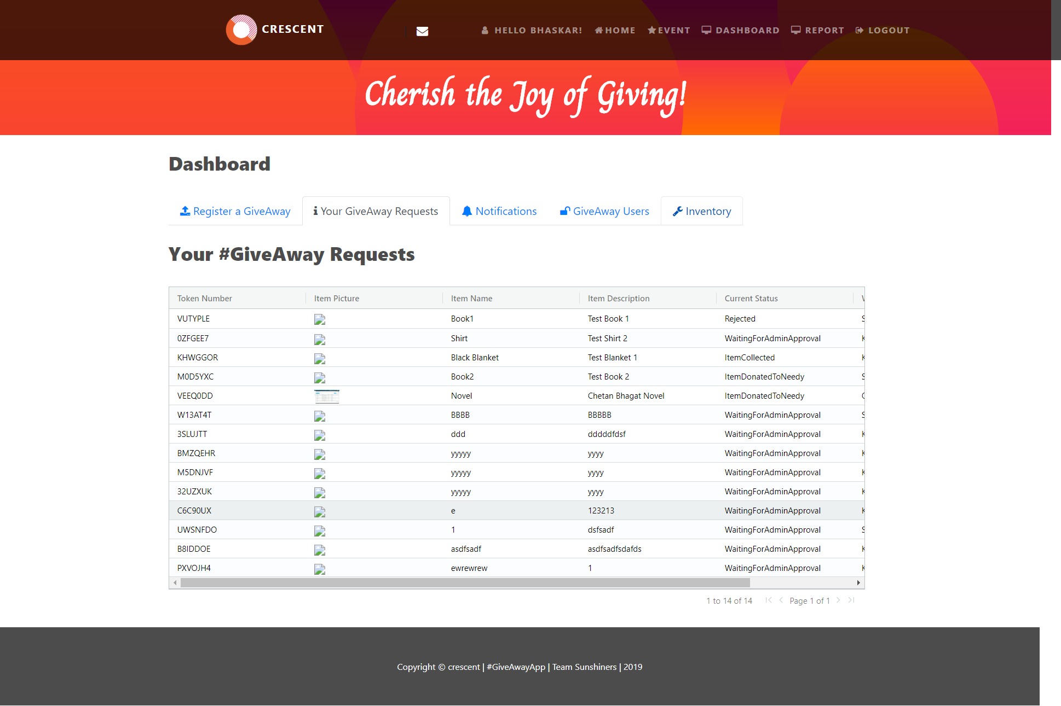
…Dashboard 2. Your GiveAway Request : This will show the Request dome by the user for Item submission in Inventory.

Slide 13
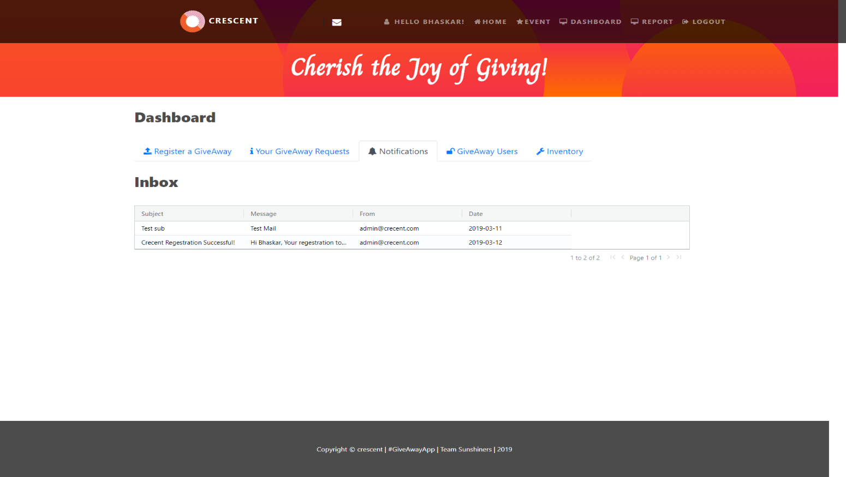
…Dashboard 3. Notifications: This screen is for showing the mail send to the User for any type of communication done at different level of transaction .

Slide 14
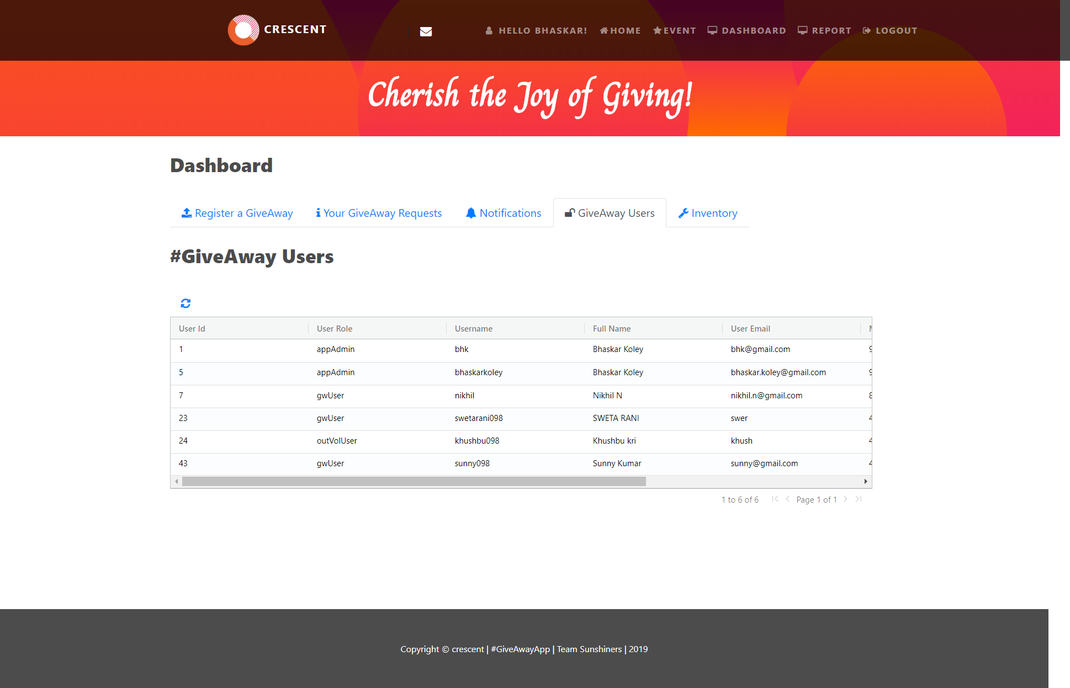
…Dashboard 4. GiveAway Users: This screen is only visible to the Application Administrator Role. This screen is for Approving / Rejecting the registered Users.

Slide 15
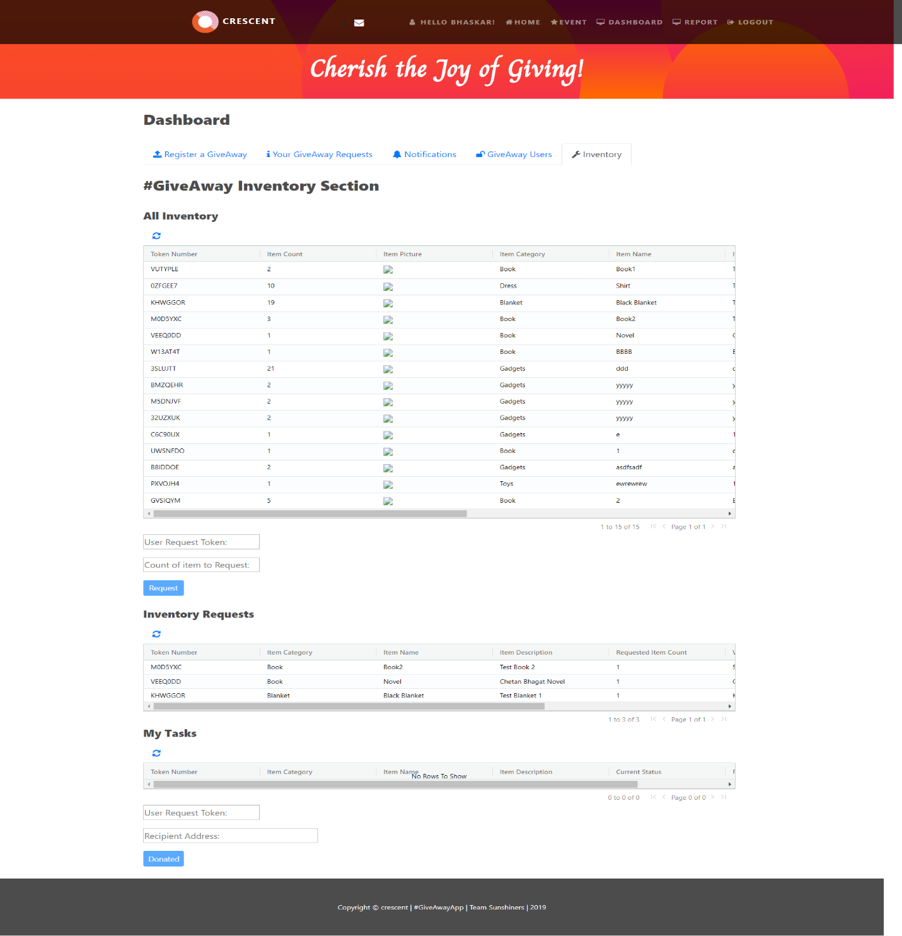
…Dashboard 5. Inventory: This screen is proving the following facilities to the Users:
Volunteer Users and Application administrator can see in their dashboard the list of available items in the inventory. For any available item in the inventory, volunteer/administrator can request to acquire that item by just few clicks. Application administrator is able to see all the raised requests and can approve/reject them. If approved, item count for the requested type gets decreased. If the item count requested is equal to the total item count for that category, upon approval of that request inventory count for that category becomes zero. Inventory count is maintained at every instance of request->approve/reject cycle. Item approved accounts for Outreach volunteer to acquire them and utilize for the need they have analyzed. Once they deliver the items, they update in their dashboard where the item was delivered and is being used.

Slide 16
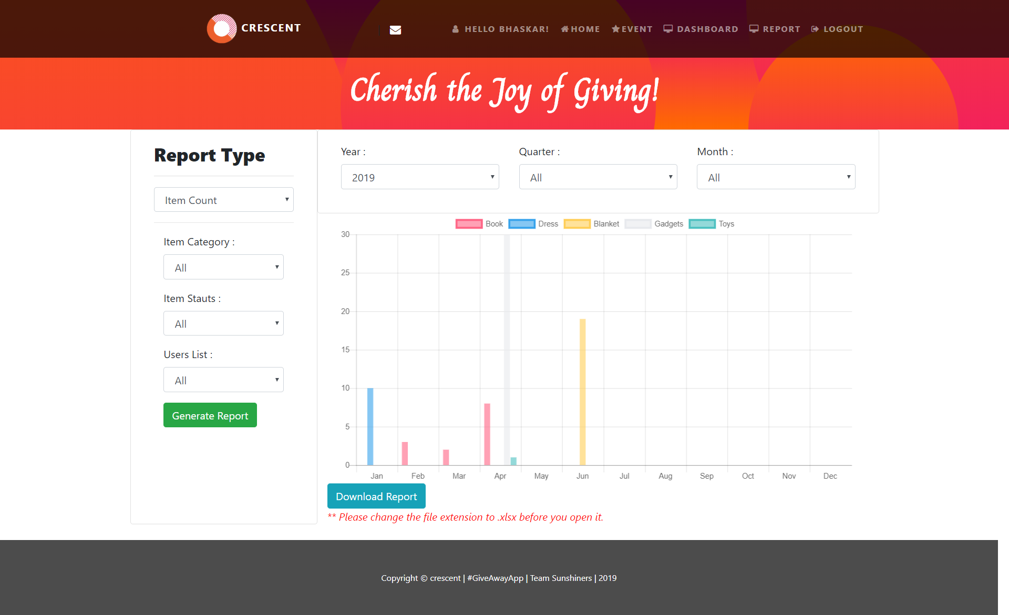
Comprehensive Report GiveAway application provides a comprehensive reporting system which allows admin to get to know the status of inventory at any time on basis of different facts and time dimension . The Reports can be generated by Admin users only.

Slide 17
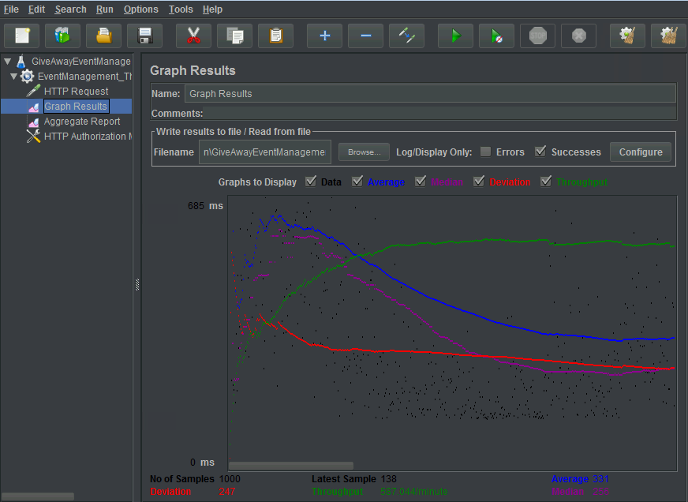
Performance/ Load Testing Using JMeter
JMeter configure for 100 users to hit EventManagement Microservice for 10 minutes.

Slide 18
In Bucket List for Crescent’s – GiveAwayApp / Future Scope
Maintaining a Book Library has been kept as a future scope of development in the application.
The application’s architecture and build phase has been covered in such a way that it is very easier to leverage and scale the application to include a full-fledged Book Library for needy as well. This will help in generating the minimum revenue that can help website run un-interruptedly.
We also aim to make this application to be used widely by making it available across different locations, outside of India as well. Once we have the approval we will plan for adding more no of warehouse centers at other locations.

Slide 19
Thank You
CRESCENT
#AGiveAwayApp - Cherish the Joy of Giving!

